Slide 1
Layout and Organization
Clear Order:
Establish a clear visual order with a title that stands out, followed by sections like Introduction, Methods, Results, discussion, and Conclusion and future work or recommendation.
Readability:
Use a legible font (like Arial are often preferred).
Maintain a font size that is easily readable from a distance (recommended size for headings is 46 and main text is 24-36 points).
Logical Flow:
Organize content in a logical flow that follows the scientific method (Introduction, Methods, Results, discussion, and Conclusion and future work or recommendation).
Use clear headings to guide the reader through the content.
Consistency:
Maintain consistency in font styles, colors, and formatting throughout the poster.
Visual Elements:
Graphics and Images:
Include relevant and high-quality graphics, charts, and images.
Ensure all visuals are labeled, and captions are concise but informative.
Whitespace:
Use whitespace strategically to enhance readability and avoid clutter.
Ensure proper spacing between text, images, and sections.
Content:
Conciseness:
Be concise in your text. Use bullet points and short paragraphs to convey information efficiently.
Key Messages:
Clearly communicate the main message and key findings of your research.
Use visuals to supplement and reinforce your key points.
Proofread:
Thoroughly proofread your poster for spelling and grammatical errors.
Remember that a well-designed scientific poster should effectively convey your research to a diverse audience and generate interest in your work.

Slide 2
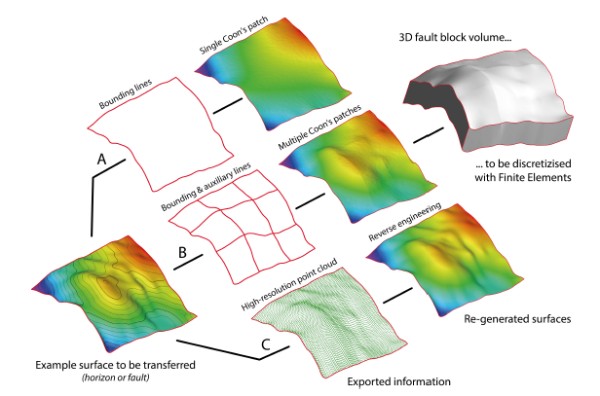
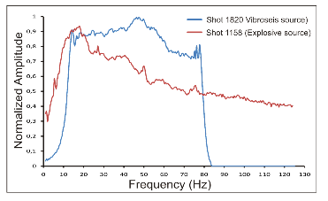
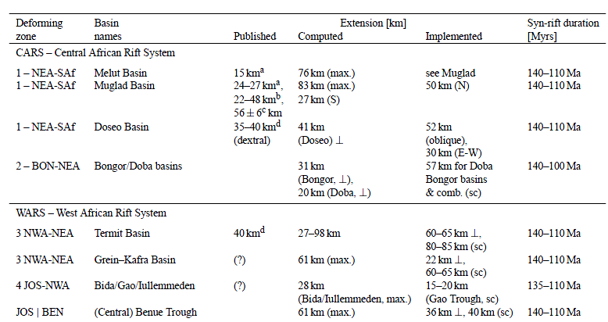
This is the title of my poster. This is the title of my poster. This is the title of my poster. This is the title of my poster. This is the title of my poster.
Author(s)
University of Jeddah, College of………, Department of…………
Submission No: (------------)
Introduction
Results and Discussion
Enter your introduction here.. This is my introduction. This is my introduction. This is my introduction. This is my introduction. This is my introduction. This is my introduction. This is my introduction. This is my introduction. This is my introduction. This is my introduction. This is my introduction. This is my introduction. This is my introduction. This is my introduction. This is my introduction. This is my introduction. This is my introduction. This is my introduction. This is my introduction. This is my introduction. This is my introduction. This is my introduction. This is my introduction. This is my introduction. This is my introduction. This is my introduction. This is my introduction. This is my introduction. This is my introduction. This is my introduction. This is my introduction. This is my introduction. This is my introduction. This is my introduction. This is my. This is my introduction. This is my introduction. This is my introduction. This is my introduction. This is my introduction. This is my introduction. This is my introduction. This is my introduction. This is my introduction. This is my introduction This is my introduction. This is my introduction. This is my introduction. This is my introduction. This is my introduction This is my introduction. This is my introduction. This is my introduction. This is my introduction. This is my introduction This is my introduction. This is my introduction. This is my introduction. This is my introduction. This is my introduction This is my introduction. This is my introduction. This is my introduction. This is my introduction. This is my introduction This is my introduction. This is my introduction. This is my introduction. This is my introduction. This is my introduction This is my introduction. This is my introduction. This is my introduction. This is my introduction. This is my introduction This is my introduction. This is my introduction. This is my introduction. This is my introduction. This is. This is my introduction. This is my introduction This is my introduction. This is my introduction. This is my introduction. This is my introduction. This is my introduction This is my introduction. This is my introduction. This is my introduction. This is my introduction. This is. This is my introduction. This is my introduction This is my introduction. This is my introduction. This is my introduction => BETTER YOU USE BULLETS
These are my results. These are my results. These are my results. These are my results. These are my results. These are my results. These are my results. These are my results. These are my results. These are my results. These are my results. These are my results. These are my results. These are my results. These are my results. These are my results. These are my results. These are my results. These are my results. These are my results. These are my results. These are my results. These are my results. These are my results. These are my results. These are my results. These are my results.
This is a figure caption. This is a figure caption. This is a figure caption. This is a figure caption. This is a figure caption.
This is a figure caption. This is a figure caption. This is a figure caption. This is a figure caption. This is a figure caption.
Aim of the work
This is a table caption. This is a table caption. This is a table caption. This is a table caption.
Enter your objective. Enter your objective. Enter your objective. Enter your objective. Enter your objective. Enter your objective. Enter your objective. Enter your objective. Enter your objective. Enter your objective Enter your objective. Enter your objective. Enter your objective. Enter your objective. Enter your objective Enter your objective. Enter your objective. Enter your objective. Enter your objective. Enter your objective Enter your objective. Enter your objective. Enter your objective. Enter your objective. Enter your objective Enter your objective. Enter your objective. Enter your objective. Enter your objective. Enter your objective Enter your objective. Enter your objective. Enter your objective. Enter your objective. Enter your objective Enter your objective. Enter your objective. Enter your objective. Enter your objective. Enter your objective Enter your objective. Enter your objective. Enter your objective. Enter your objective. Enter your objective Enter your objective. Enter your objective. Enter your objective. Enter your objective. Enter your objective Enter your objective. Enter your objective. Enter your objective. Enter your objective. Enter your objective Enter your objective. Enter your objective. Enter your objective. Enter your objective. Enter your objective Enter your objective. Enter your objective. Enter your objective. Enter your objective. Enter your objective Enter your objective. Enter your objective. Enter your objective. Enter your objective. Enter your objective Enter your objective. Enter your objective. Enter your objective. Enter your objective. Enter your objective Enter your objective. Enter your objective. Enter your objective. Enter your objective. Enter your objective Enter your objective. Enter your objective. Enter your objective. Enter your objective. Enter your objective
Methodology
Conclusion and future prospective
Enter your methods here. These are my methods and Materials. These are my methods and Materials. These are my methods and Materials. These are my methods and Materials. These are my methods and Materials. These are my methods and Materials. These are my methods and Materials. These are my methods and Materials. These are my methods and Materials. These are my methods and Materials. These are my methods and Materials. These are my methods and Materials. These are my methods and Materials. These are my methods and Materials. These are my methods and Materials. These are my methods and Materials. These are my methods and Materials. These are my methods and Materials. Enter your methods here. These are my methods and Materials. These are my methods and Materials. These are my methods and Materials. These are my methods and Materials. These are my methods and Materials. These are my methods and Materials. These are my methods and Materials. These are my methods and Materials. These are my methods and Materials. These are my methods and Materials. These are my methods and Materials. These are my methods and Materials. These are my methods and Materials. These are my methods and Materials. These are my methods and Materials. These are my methods and Materials. These are my methods and Materials. These are my methods and Materials. are my methods and Materials. These are my methods and Materials. These are my methods and Materials. These are my methods and Materials. These are my methods and Materials. These are my methods and Materials. These are my methods and Materials. These are my methods and Materials. These are my methods and Materials.
This is my conclusion. This is my conclusion. This is my conclusion. This is my conclusion. This is my conclusion. This is my conclusion. This is my conclusion. This is my conclusion. This is my conclusion. This is my conclusion. This is my conclusion. This is my conclusion. This is my conclusion. This is my conclusion. This is my conclusion. This is my conclusion. This is my conclusion. This is my conclusion.
This is my conclusion. This is my conclusion. This is my conclusion. This is my conclusion. This is my conclusion. This is my conclusion. This is my conclusion. This is my conclusion. This is my conclusion. This is my conclusion. This is my conclusion. This is my conclusion. This is my conclusion. This is my conclusion. This is my conclusion. This is my conclusion. This is my conclusion. This is my conclusion.
This is my conclusion. This is my conclusion. This is my conclusion. This is my conclusion. This is my conclusion. This is my conclusion. This is my conclusion. This is my conclusion. This is my conclusion. This is my conclusion. This is my conclusion. This is my conclusion. This is my conclusion. This is my conclusion. This is my conclusion. This is my conclusion. This is my conclusion. This is my conclusion.
This is my conclusion. This is my conclusion. This is my conclusion. This is my conclusion.
=> BETTER YOU USE BULLETS
Acknowledgement
Acknowledgement. Acknowledgement. Acknowledgement. Acknowledgement. Acknowledgement. Acknowledgement. Acknowledgement. Acknowledgement. Acknowledgement. Acknowledgement. Acknowledgement. Acknowledgement. Acknowledgement. Acknowledgement
References
[1] References. References. References. References. References. References. References. References. References. References.
[2] References. References. References. References. References. References. References. References. References. References.
[4] References. References. References. References. References. References. References. References. References. References.
[5] References. References. References. References. References. References. References. References. References..

